Slide 1


Incident Management System:
Application to Public Health
Public health CBRN course
Dan Cass, MD, FRCPC &
Brian Schwartz MD, CCFP(EM), FCFP
Scientific Advisor, Emergency Management Unit, MOHLTC

Slide 2
Goals of Session
Outline the evolution of the Incident Management System (IMS) model
Provide an overview of the principles of IMS
Illustrate how IMS can be used as a framework for emergency response for the health sector
Provide some practical applications of IMS for public health

Slide 3
What is IMS?
A way of creating (some!) order out of chaos
A framework
A tool

Slide 4
Terminology
For our purposes, all of these terms are interchangeable:
  Incident Management System (IMS)
  Incident Command System (ICS)
  Hospital Incident Command System (HICS)

Slide 5
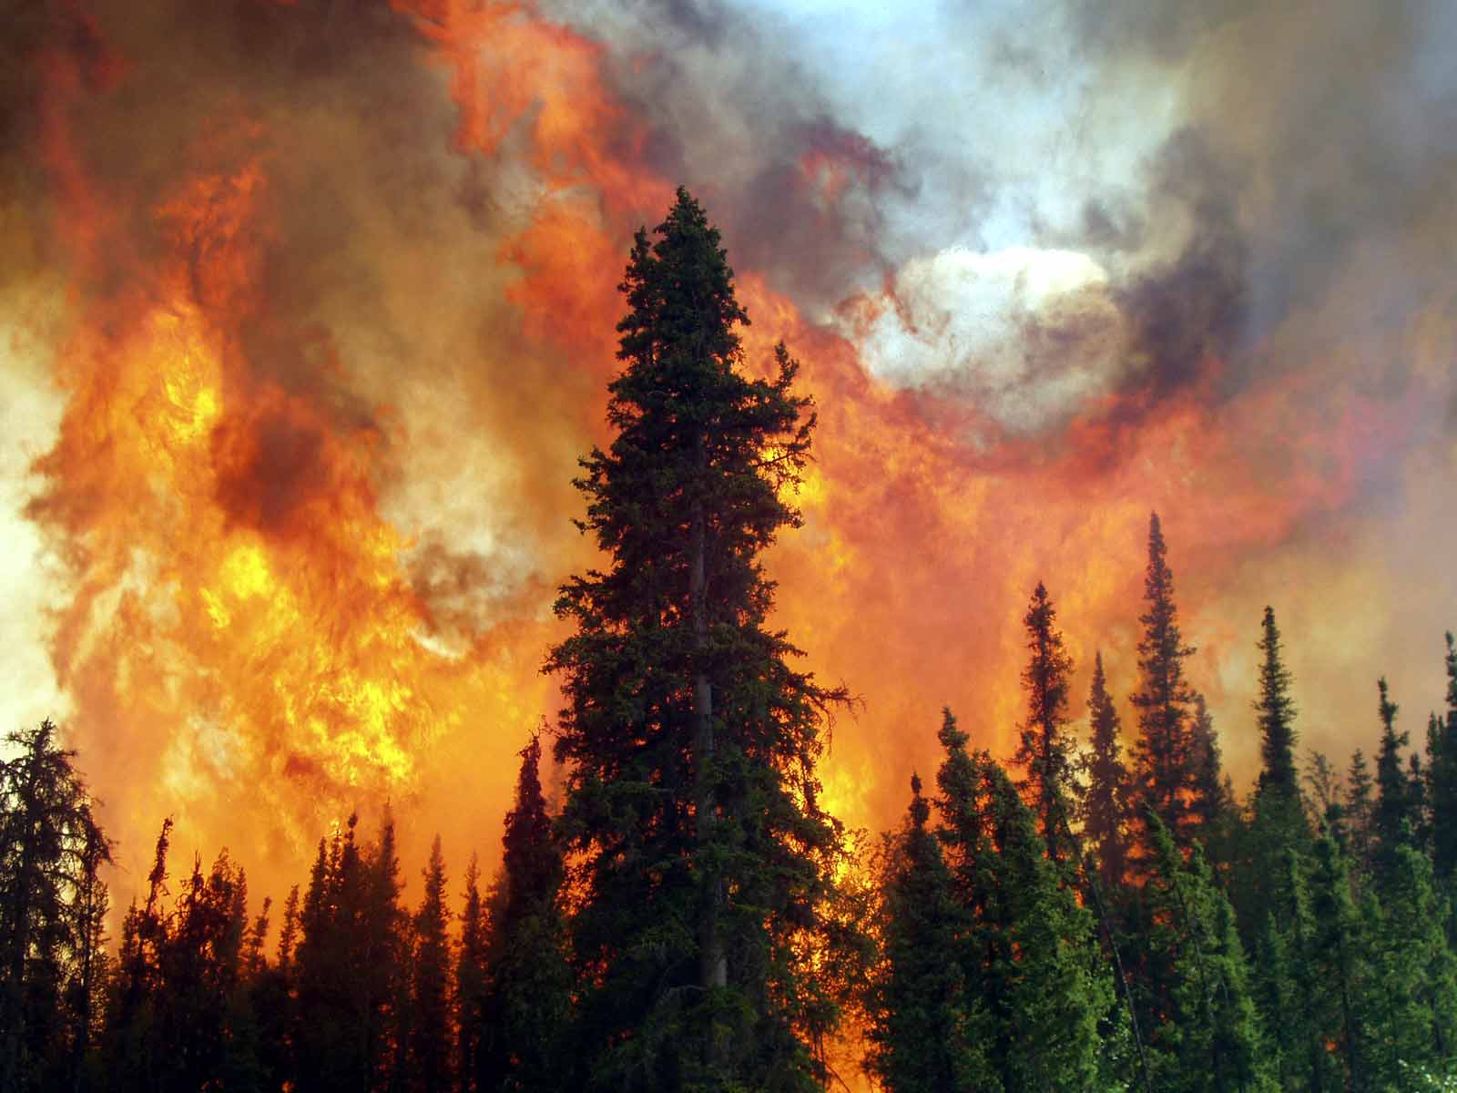
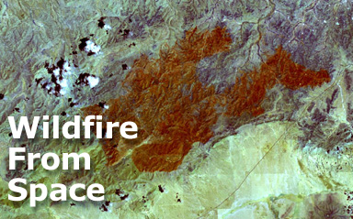
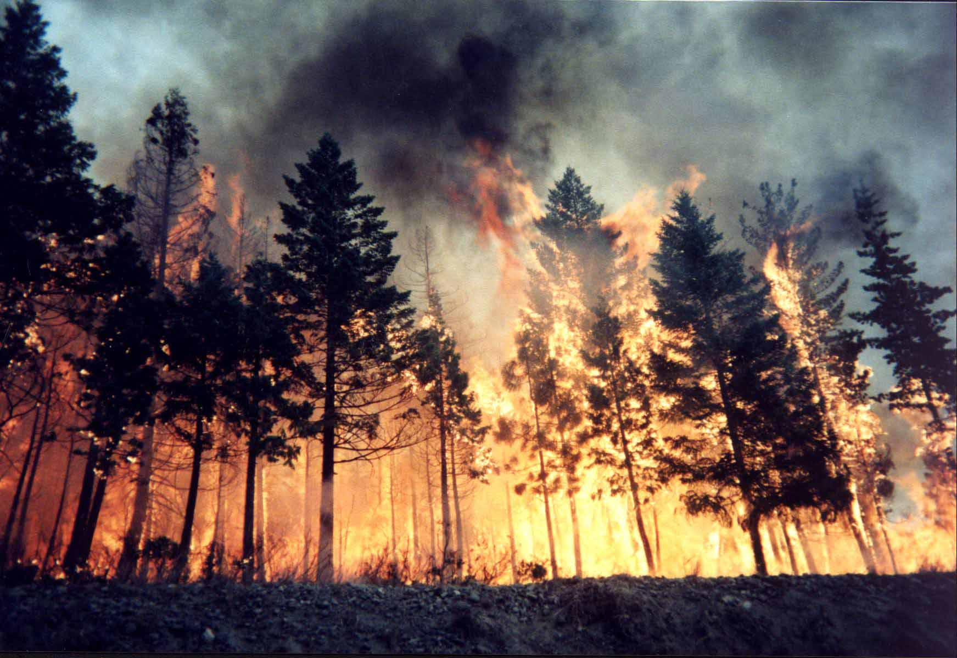
Where Does IMS Come From?

Slide 6
Origins of IMS
California wildfires, 1980s – “FIRESCOPE”
  Multiple fire agencies involved
    Local, regional
  Coordination of local / state / federal resources
Many challenges…
  Lack of common terminology / organizational structure / roles
  Incompatible equipment (radios; firefighting)

Slide 7
Origins of IMS
Fire protection agencies developed common organizational and response structure
  Evolved into IMS
Deployed across California
  Subsequently to much of USA and Canada
Began to expand to all pre-hospital providers (fire / ambulance / police)
  Eventually into other areas of health sector

Slide 8
Origins of IMS
1987: Hospital Council of Northern California
  Adapted IMS into “Earthquake Preparedness Guidelines for Hospitals”
1991: Orange County EMS
  Used IMS principles to develop Hospital Emergency Incident Command System (HEICS)
    2006 → Hospital Incident Command System (HICS)
Has been adapted to a variety of health sectors / environments (including public health)

Slide 9
Why Should We Care??
In day-to-day operations, health care organizations often very insular
  “Our” procedures don’t have to be same as “their” procedures
  Applies within as well as between organizations
In mass casualty incident, we cannot operate in a vacuum!
  Need way to communicate / coordinate efforts

Slide 10
IMS - Components
  Unified command structure
  Common terminology
  Modular organization
  Integrated communication
  Consolidated action plans
  Job Action Sheets
  Manageable & sensible span of control
  Designated facilities
  Comprehensive resource management

Slide 11
IMS Structure
Command
Operations
Planning
Logistics
Finance /
Administration

Slide 12
IMS Structure
Command
Operations
Planning
Logistics
Finance /
Administration
Doers
Thinkers
Getters
Payers

Slide 13
Incident Command
Incident Commander
Operations
Planning
Logistics
Finance
Directs activities of personnel in Emergency Operations Centre (EOC)
Most senior trained responder
  In Public Health, may start as on-call Medical Officer of Health, Nurse, Manager or Public Health Inspector
As response progresses, IC position may be “handed off” to more senior person

Slide 14
Operations
Incident Commander
Operations
Planning
Logistics
Finance
Directs “front-line” response to event
Implements response activities as determined by Incident Commander
Maintains communication between EOC and site
Requests and assigns resources as directed

Slide 15
Planning
Incident Commander
Operations
Planning
Logistics
Finance
“What’s next?”
Control and flow of all information
Data collection, analysis and forecasting
Development of response and recovery objectives and strategies
Mutual Aid requests

Slide 16
Logistics
Incident Commander
Operations
Planning
Logistics
Finance
Support Operations
Acquire and allocate resources and provide all materials, equipment, and personnel required
Application of additional resources provided by Mutual Aid

Slide 17
Finance
Incident Commander
Operations
Planning
Logistics
Finance
Tracking of expenses
Funding
Government Financial Aid requests
Financial Aid distribution

Slide 18
IMS Structure
Command
Safety
Information
Liaison
Operations
Planning
Logistics
Finance /
Administration
Response
Team(s)

Slide 19
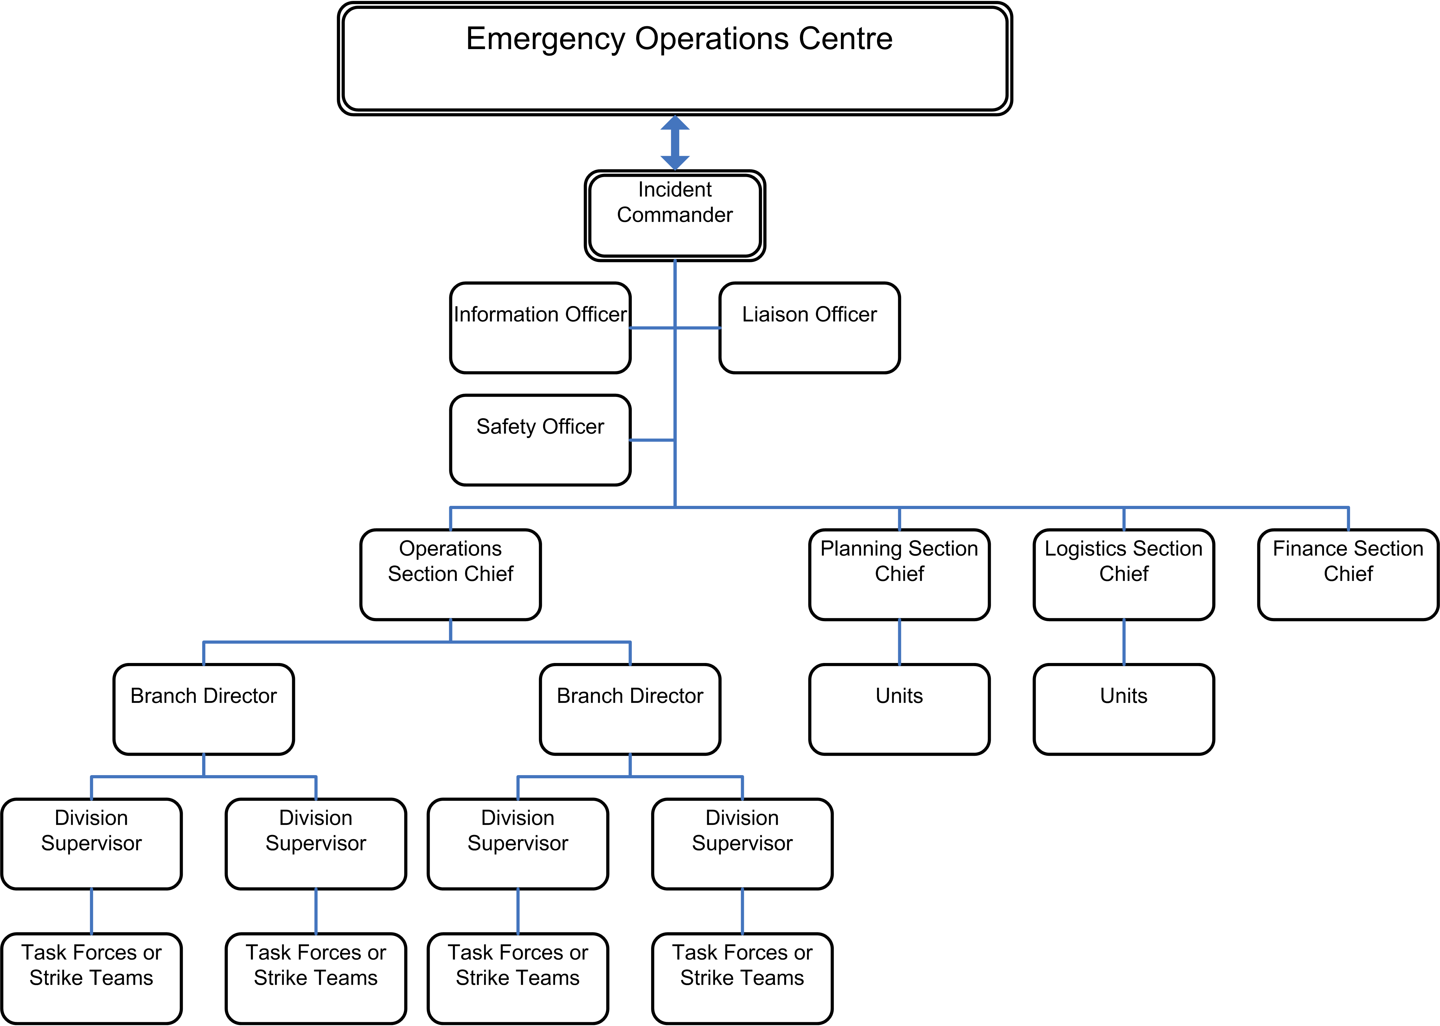

Slide 20
IMS - Components
  Unified command structure
  Common terminology
  Modular organization
  Integrated communication
  Consolidated action plans
  Job Action Sheets
  Manageable & sensible span of control
  Designated facilities
  Comprehensive resource management

Slide 21
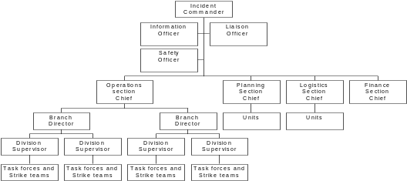
Provincial
Regional
Local
Local
Local

Slide 22
IMS - Components
  Unified command structure
  Common terminology
  Modular organization
  Integrated communication
  Consolidated action plans
  Job Action Sheets
  Manageable & sensible span of control
  Designated facilities
  Comprehensive resource management

Slide 23
Modular Organization
IMS model is scaleable
Position = role
  One person may have several roles, especially in smaller-scale response
Activate only those positions you need for a given response
  HICS - concept of “minimal activation”

Slide 24
IMS - Components
  Unified command structure
  Common terminology
  Modular organization
  Integrated communication
  Consolidated action plans
  Job Action Sheets
  Manageable & sensible span of control
  Designated facilities
  Comprehensive resource management

Slide 25
Integrated Communications
Who?
Liaison Officer (in EOC)
  Point of contact with external agencies (EMS; other Public Health Units, hospitals, MOHLTC etc.)
Public Information Officer (in EOC)
  Deals with media / public

Slide 26
Integrated Communications
How?
Ensure able to communicate
  Established means
    Dedicated lines
  Established frequencies
    Encryption!
  BACKUP plan!

Slide 27
IMS - Components
  Unified command structure
  Common terminology
  Modular organization
  Integrated communication
  Consolidated action plans
  Job Action Sheets
  Manageable & sensible span of control
  Designated facilities
  Comprehensive resource management

Slide 28
Incident Action Plan
Part of Incident Commander’s role = development of Incident Action Plan (IAP)
  Assessment
  Objectives
  Resources
  Needs
Constantly updated / revised based on new information and progress of response

Slide 29
Incident Action Plan
Each Section Chief (Operations, Planning, Logistics, Finance) develops IAP for their area
  Immediate / Intermediate / Extended
Integrates with overall IAP

Slide 30
IMS - Components
  Unified command structure
  Common terminology
  Modular organization
  Integrated communication
  Consolidated action plans
  Job Action Sheets
  Manageable & sensible span of control
  Designated facilities
  Comprehensive resource management

Slide 31
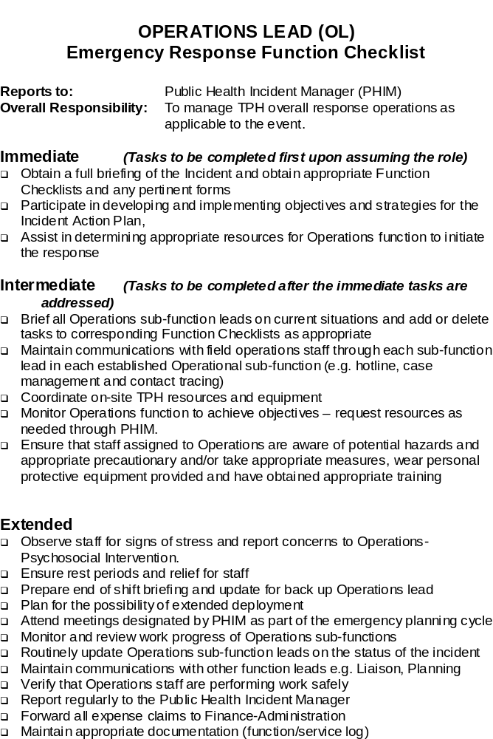
Job Action Sheet
Role title
Reports to
Mission
Tasks
  Immediate
  Intermediate
  Extended

Slide 32
IMS - Components
  Unified command structure
  Common terminology
  Modular organization
  Integrated communication
  Consolidated action plans
  Job Action Sheets
  Manageable & sensible span of control
  Designated facilities
  Comprehensive resource management

Slide 33


Span of Control: The number of subordinates that a superior can manage effectively
Ineffective
Effective
Each person responsible for a maximum of 3 to 7 subordinates
  Ideal = 1:5 command ratio
Each person reports up to one supervisor

Slide 34
IMS - Components
  Unified command structure
  Common terminology
  Modular organization
  Integrated communication
  Consolidated action plans
  Job Action Sheets
  Manageable & sensible span of control
  Designated facilities
  Comprehensive resource management

Slide 35
Designated Facilities
May identify certain sites / units to carry out specialized functions
  Public screening centres
  Immunization clinics
  Tracking / follow up

Slide 36
IMS - Components
  Unified command structure
  Common terminology
  Modular organization
  Integrated communication
  Consolidated action plans
  Job Action Sheets
  Manageable & sensible span of control
  Designated facilities
  Comprehensive resource management

Slide 37
How Does This Work in Real Life?
Incident occurs
Notification
  Official (eg – Police / MOHLTC EMU)
  Unofficial (ie people start calling…!)
On-call Medical Officer of Health becomes Incident Commander/Manager

Slide 38
Initial Response
Incident Commander =
On-Call MOH
Operations
Planning
Logistics
Finance
PH Nurse or
Inspector
PH Nurse or
Inspector

Slide 39
Initial Response (cont’d)
Priorities and objectives established
On-site command developed
Multi agency communication established
Resource needs and allocation identified
NEEDS EXCEED AVAILABLE RESOURCES

Slide 40
The Incident Progresses…
Decision to initiate local / regional plans
Fan-Out process
  Health unit staff
  Leadership
Senior on-site leader assumes IC role
  Establishes EOC / Command Post
  Begins to assign roles / responsibilities
Replaced by more senior staff as they arrive

Slide 41
Full-Scale PH Response
Incident Commander appoints key personnel
  Four section Chiefs
  Liaison / Information / Security
Job Action Sheets distributed and checklists begin
Priorities and objectives established
  Incident Action Plan(s) developed
Span(s) of control established

Slide 42
Full-Scale PH Response (cont’d)
Multi-agency communication established
Resource allocation identified
Tracking, evaluation, and cost recovery initiated
Off-site command established (as needed)
Information released to media / public
Recovery processes developed

Slide 43
Public Health IMS Model
Chair, Board of Health
Medical Officer of Health Senior Management Team
Public Health Incident Manager
Public Information
Liaison
Operations
Planning
Logistics
Administration
Mass Vaccination/Post Exposure Prophylaxis
Situation Assessment
Claims/
Compensation
Facilities
Staffing & Resource Needs
Human Resources
Hotline Operation
Costing
Reception Centre/Mass Care
Resource Deployment
Procurement
Communications Equipment
Case Management/Contact Tracing
Documentation
Miscellaneous Supplies
Environmental Inspection/ Sampling
Demobilization & Recovery
Nutrition/staff accommodation
Epidemiological Investigations
Psychosocial Intervention

Slide 44
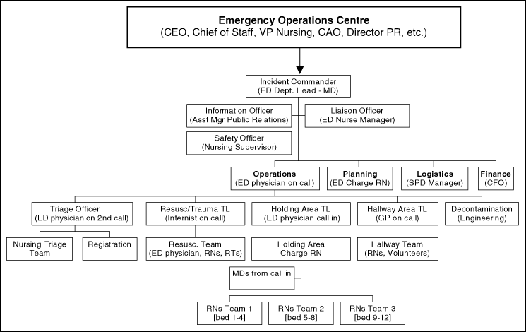
Hospital IMS Model

Slide 45
Summary
IMS is a framework for emergency response
  Ideal for health sector
Many advantages:
  Scaleable to size of event
  Common terminology / organization of roles
  Manageable span of control
  Task-oriented approach
    Job action sheets
    Incident Action Plan

